Slide 1
Journal #23
What are some diets YOU or someone you know have tried?
Did they work?
What were they??

Slide 2
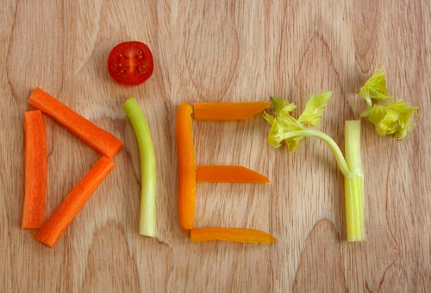
Weight Loss and Dieting

Slide 3
Weight Loss Myths Exposed!
MYTH: Skipping meals is a good way to lose weight.
FACT: Your body needs a certain amount of calories and nutrients each day to work properly. Most people who skip meals tend to eat more at their next meal or make up for the calories by snacking.
It is best to eat many small meals throughout the day that include a variety of nutritious, low-fat and low-calorie foods.

Slide 4
Weight Loss Myths Exposed!
MYTH: Eating after 8pm causes weight gain.
FACT: It doesn’t matter what time you eat- it’s how much you eat during the whole day and how much exercise you get.

Slide 5
Weight Loss Myths Exposed!
MYTH: Natural or herbal weight-loss products are safe and effective.
FACT: A product that claims to be “natural” or “herbal” is not necessarily safe. These products are not usually tested scientifically to prove that they are safe or that they work.
Also, these products may be unsafe for people with certain medical conditions.

Slide 6
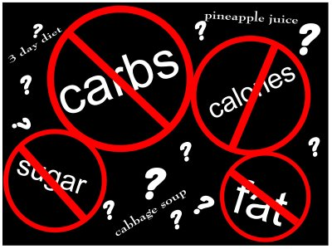
FAD DIETS: ATKINS
The Atkins diet is a low carb diet created by Robert Atkins.
Atkins felt that the most unrecognized factors in Western obesity was the consumption of refined caarbs such as high fructose corn syrup (found in ketchup, sweeteners) flour, and sugar.
Since our bodies burn carbs first, by reducing carb intake, our bodies would burn fat instead.
There are 4 phases of the diet:
1) 2 weeks – Eat only 20 g of carbs a day where 12-15 come from a list of 54 allowed vegetables.
Drink 8 glasses of water a day, no alcohol and limited caffeine.
Liberal amounts of fish, meat and poultry is allowed.
A weight loss of 5-10 pounds a week is expected.

Slide 7
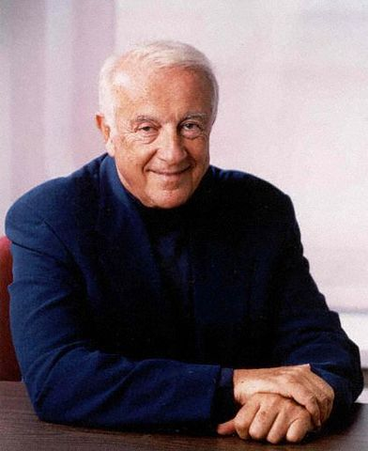
ATKINS
Phase 2: Ongoing Weight Loss:
You are allowed to introduce a bit more carbs, increasing by 5 net carbs per week.
There is a “9 rung ladder” one follows for food introduction.
Phase 3: Pre-Maintanece
Increase carb intake again, this time by 10 net carbs.
Find ones “critical carb level for maintenance” that is, how much carbs a person can eat without gaining weight.
Phase 4: Carrying out the diet and not going back to old habits.

Slide 8
Controversies
The Atkins diet is still under debate.
Some say that the Atkins diet promotes heart disease and that those on the Atkins diet are depriving their body of needed glucose to function properly. It takes a long time for the body to break down protein and fat and get to the brain for use.
Also, some say in the long run the Atkins diet can have a negative effect on a person’s kidneys, and may cause bone loss.
The diet is very prescriptive, very restrictive, and limits half of the foods we normally eat," she says. "In the end it's not fat, it's not protein, it's not carbs, it's calories. You can lose weight on anything that helps you to eat less, but that doesn't mean it's good for you."

Slide 9
Created by an overweight woman in Queens named Jean Nidetch. She called her friends over and confessed that eating cookies was her obsession. She lost 70 pounds and came to the realization that empathy and rapport and understanding can help in weight loss.
They have a “Four Way” Approach to weight loss
1) Eat Smarter
2) Move More
3) Helpful Habits
4) Get Support

Slide 10
WEIGHT WATCHERS
In the U.S. a person must weight at least 5 pounds more than the minimum weight for a person their height to join.
Once a member, a person uses a weight loss formula according to their weight. They are allotted a certain amount of points. Every food has a point value.
As you loose weight, your points get reduced.
A member will weigh in during weekly meetings until you meet your goal weight.
Once a lifetime member (reached goal weight) you must stay within 2-3 pounds of your goal weight in order to not pay at weigh ins.

Slide 11
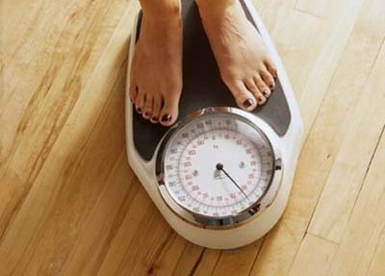
PROS AND CONS
Cost:
There are sign up discounts available.
It costs a member about $40 a month
PROS
The support group has proven good for people. The weigh ins hold a sense of accountability.
You can eat regular food as long as you are staying in your point range.
It is popular and many food items and restaurant menus have weight watcher options.
CONS
It can be long and tedious
It is a task to weigh food and count points, requires commitment.

Slide 12
FAD DIETS: SOUTH BEACH
Designed by cardiologist Arthur Agaston and dietician Marie Almon.
Originally created to prevent heart disease.
Based on the glycemic index (how your blood sugar rises in response to food)
The diet:
Replace “bad carbs” with “good carbs” and “bad fats” with “good fats.”
Which means eliminating trans-fats and discourages saturated fats.
The South Beach diet replaces these with unsaturated fats and omega-3 fatty acid.
Specifically excluding red meat and poultry and replacing them with lean meats, nuts and oily fish.

Slide 13
South Beach
Phase 1: lasts 2 weeks
Eliminates all sugars, processed carbs, fruits and some vegetables.
Phase 2: as the long as the dieter wants to loose weight.
In this stage, most fruits and vegetables and some whole grains are re-introduced.
Phase 3: lasts for life
There is no specific list of permitted and prohibited foods, instead the dieter is expected to understand the basic principles of the diet and live by them.

Slide 14
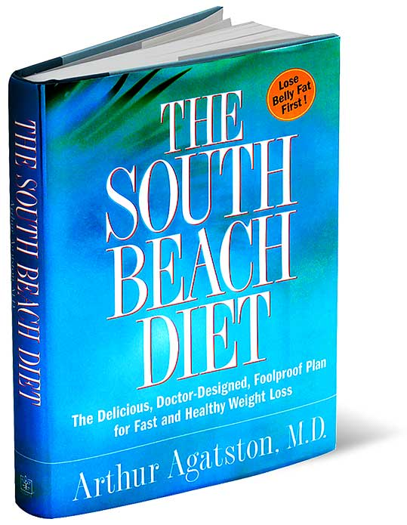
South Beach
CONS:
Very restrictive first phase
Not enough structure throughout phases where introducing more foods is allowed.
Not a lot of scientific backing and research
Costly ingredients for recipes
PROS:
No counting
No cost of food
Eat foods off a prescribed list
Nutritious
Weight loss is fast

Slide 15
Master Cleanse
What is it?
How does it work?
Is it safe?
http://health.usnews.com/best-diet/master-cleanse-lemonade-diet

Slide 16
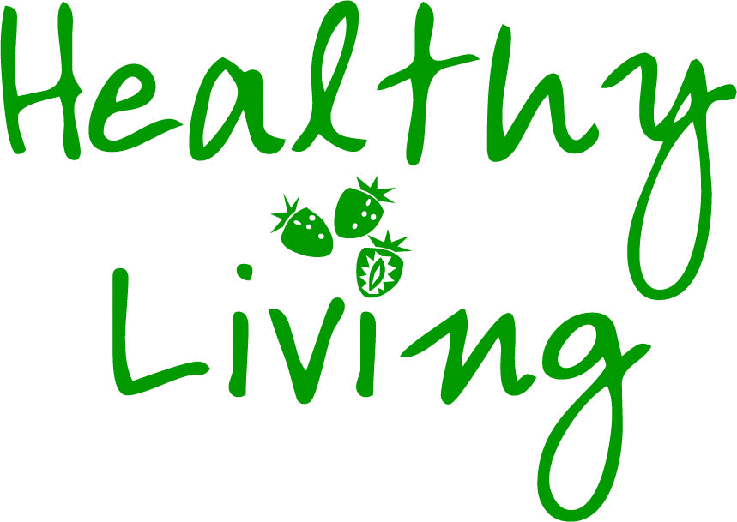
The BEST diet
Diets in summary: “You can lose weight on anything that helps you to eat less, but that doesn't mean it's good for you.”
Formula to live by:
Food and beverage intake + energy output = WEIGHT!!!!!
Forming life-long excessive and healthy eating habits is KEY!
Healthy Weight Loss:
Include a variety of foods
Limit calories
Encourage nutrient dense foods
Limit fats and sugars
Stay active

