Slide 1
Journal #14
What does stimulant mean?
What does Carcinogen mean?
What is passive smoke?
What is the average cost a smoker will spend in a year on cigarettes?
What does withdrawal mean?

Slide 2
TOBACCO DAY 2

Slide 4
Tobacco
Smoking Causes…
- Cancer
- Respiratory Diseases
- Heart Disease and Heart Attacks
- Chronic Coughing
- Increased Phlegm
- Rheumatoid Arthritis
- Infertility
- Impotence
- Hearing Loss and Vision Problems
- Decrease in Smell and Taste
- Stress

Slide 5
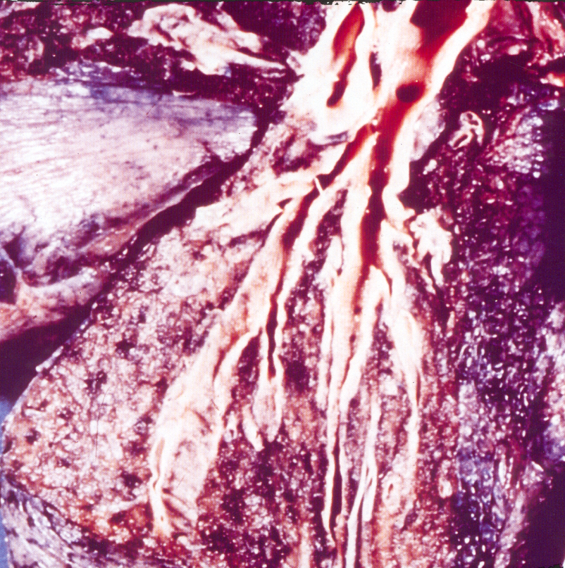
A Comparison of Lungs
Healthy Lung
Smokers Lung

Slide 7
Second Hand Smoke
https://www.youtube.com/watch?v=B1DNoole3Wo
http://www.wwmt.com/news/features/top-stories/stories/Author-of-bill-prohibiting-smoking-in-car-with-kids-speaks-out-about-reasoning-150486.shtml#.VhP45OxViko

Slide 8
Smoking Also Causes…
Bad breath
Yellow teeth
Smelly hair & clothes
Yellow fingernails
Premature wrinkling of the skin

Slide 9
Tips from a former smoker
https://www.youtube.com/watch?v=5zWB4dLYChM

Slide 10
Spit Tobacco
Spit tobacco can lead to oral cancer, gum disease, tooth decay, and nicotine addiction, and increases the risk of cardiovascular disease, including heart attack.
Constant exposure to tobacco juice causes cancer of the esophagus, pharynx, larynx, stomach, and pancreas.
Smokeless tobacco users are up to 50 times more likely to get oral cancer than non-users.

Slide 11
This is Sean Marsee. He began to spit at age 12 because he thought it was safer than smoking. He ran track and won the state championship in high school. But after he graduated he had to have his throat and tongue removed. He died at age 19 from mouth cancer caused by using spit tobacco.

Slide 12
Chewing Tobacco
http://www.foxnews.com/health/slideshow/2014/07/02/faces-smokeless-tobacco-use/#/slide/bender-edited1

Slide 13
So what's in a cigarette?

Slide 14
Arsenic
used in ant poison and rat poison

Slide 15
Ammonia
toilet cleaner

Slide 16
Carbon Monoxide
in car exhaust

Slide 17
Acetone
used in nail polish remover and paint stripper

Slide 18
Formaldehyde
used to preserve dead bodies

Slide 19
Butane
used in lighter fluid

Slide 20
DDT
used as an insecticide (was banned on farms because it’s so harmful)

Slide 21
Tar
used to make roads, coats your lungs and causes lung cancer

Slide 22
Cyanide
used in rat poison

Slide 23
The one major thing all these chemicals have in common is their lack of oxygen. We all know how important oxygen is to our bodies. When you smoke, it reduces the amount of oxygen in your blood, reducing your stamina for sports and other physical activities.

Slide 24
How to Quit
Quitting takes hard work and a lot of effort, but – you can quit smoking.

Slide 25
Five Keys for Quitting
Get ready
Get support
Learn new skills and behaviors
Get medication and use it correctly
Be prepared for relapse or difficult situations

Slide 26
Get Ready
Set a quit date.
Change your environment.
- Get rid of all cigarettes and ashtrays in your home, car, and place of work.
- Don’t let people smoke in your home.
Review your past attempts to quit. Think about what worked and what did not.
Once you quit, don’t smoke—Not Even A Puff!

Slide 27
Get Support and Encouragement
Tell your family, friends, and coworkers that you are going to quit and want their support. Ask them not to smoke around you or leave cigarettes out.
Talk to your health care provider (for example, doctor, nurse, pharmacist, psychologist, or smoking counselor).
Get individual, group, or telephone counseling.

Slide 28
Learn New Skills and Behaviors
Try to distract yourself from urges to smoke. Talk to someone, go for a walk, get busy with a task or project.
Change your routine. Use a different route to work. Drink tea instead of coffee. Reduce or eliminate your alcohol intake.
Do something to reduce your stress. Take a hot bath, exercise, or read a book.
Plan something enjoyable to do every day.
Drink a lot of water and other fluids.

Slide 29
Get Medication And Use It Correctly
The FDA has approved five medications to help you quit smoking:
- Bupropion SR – available by prescription
- Nicotine Inhaler – available by prescription
- Nicotine Nasal Spray – available by prescription
- Nicotine Gum – available over-the-counter
- Nicotine Patch – available by prescription and over-the-counter
If you’re serious about quitting, these meds could double your chances of quitting and quitting for good.

Slide 30
Be Prepared For Relapse or Difficult Situations
Alcohol. Avoid drinking alcohol. Drinking lowers your chances of success.
Other Smokers. Being around smoking may make you want to smoke.
Weight Gain. Not everybody gains weight when they quit. If they do, it’s usually less than 10 pounds. Don’t let weight gain distract you from your main goal—quitting smoking.
Bad Mood or Depression. There are many ways to improve your mood other than smoking.

Slide 31
Anti- Smoking Ad

