Slide 1
Journal #15
1)What is the function of the urethra for men? Women?
2)What male glands are responsible for secreting fluid/mucus that make up semen?
3) What is menopause?
4) What is circumcision?

Slide 2
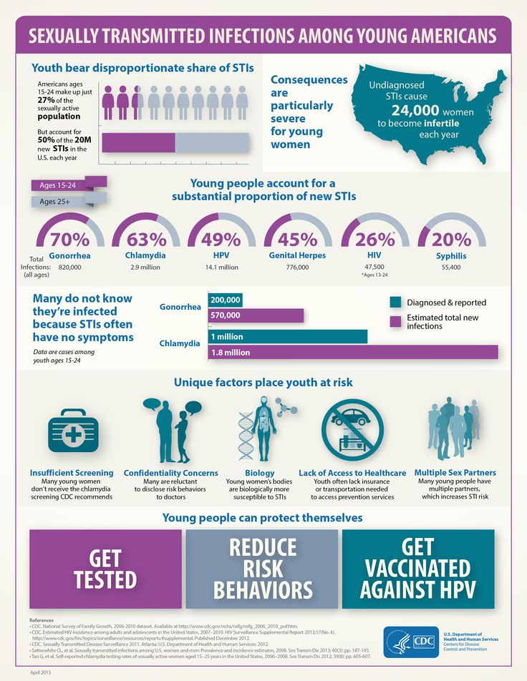

Slide 3
Rates of sexually transmitted diseases (STDs) in China have soared over the past decade. Surveillance data indicate that the incidence of syphilis increased nearly 20 times from 1990 to 1998

Slide 4
STI'S
Sexually transmitted infections

Slide 6
Chlamydia
The Most common BACTERIAL STD in the U.S
SIGNS AND SYMPTOMS :
infected females may have yellowish vaginal discharge or show no symptoms at all.
infected males usually experience painful, frequent urination and discharge from the penis.
:

Slide 7
Chlamydia
TREATMENT : antibiotics
if untreated, Chlamydia can lead to pelvic inflammatory disease (PID), which may cause infertility.

Slide 8
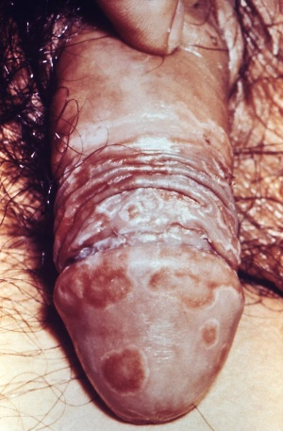
Chlamydia

Slide 9
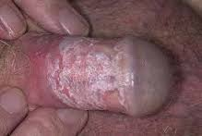

Slide 11
Gonorrhea
SIGNS AND SYMPTOMS :
infected males have a thick, puslike discharge from the penis and painful urination.
infected females have painful urination and puslike discharge from the vagina.
TREATMENT :
antibiotics, usually penicillin.

Slide 12
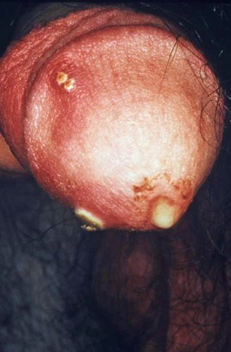
Gonorrhea

Slide 14
Genital Warts
SIGNS AND SYMPTOMS :
VIRAL STI
warts appear in clusters around the genitals.
itching and a burning sensation around the warts.
once a person is infected, the virus remains in the body for life.

Slide 15
Genital Warts con’t
TREATMENT :a physician may remove the warts but the virus will remain, so the warts may appear again.

Slide 16
HPV
Human papillomavirus (HPV) is a group of viruses that are extremely common worldwide.
HPV is the most common sexually transmitted infection (STI). HPV is so common that nearly all sexually active men and women get it at some point in their lives.
There are more than 100 types of HPV, of which at least 13 are cancer-causing (also known as high risk type).

Slide 17
There is no test to find out a person’s “HPV status.”
HPV is mainly transmitted through sexual contact and most people are infected with HPV shortly after the onset of sexual activity.
Cervical cancer is caused by sexually acquired infection with certain types of HPV.

Slide 18
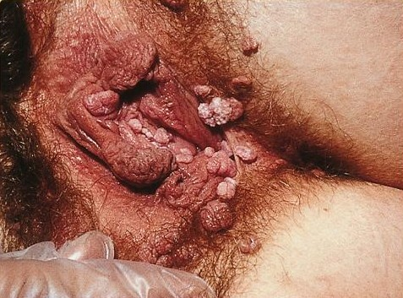
Genital Warts

Slide 19
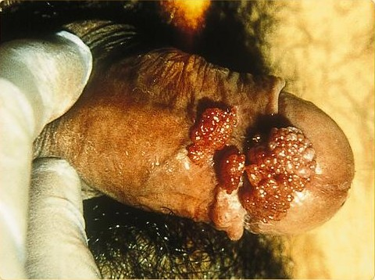
Genital Warts

Slide 20
Genital Herpes
It is a viral STD. No Cure!
Symptoms for boys and girls:
Blisters on or around the genitals that break, leaving sores.
Can be transmitted whether or not sores are present.

Slide 21
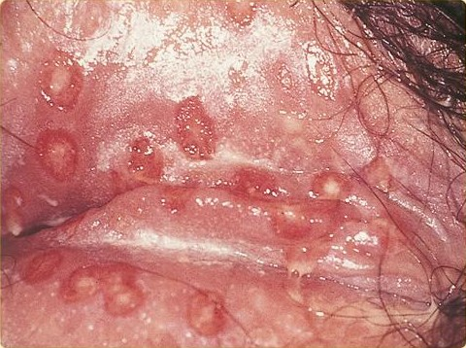
Genital Herpes

Slide 22
Syphilis
Passed from person to person through direct contact with a syphilis sore.
These sores occur mainly on the genitals.
Many people do not have any symptoms for years.
Stages of syphilis:
First stage – sore on genitals

Slide 23
Syphilis Con’t
Second stage – Rash: brownish red, rough spots, on the bottom of feet, and palms of hands.
The rash will go away without treatment, but the disease is still present.
Third stage – damage to brain, eyes, nerves, heart, bones, liver, joints.
Damage in this stage can cause death.

Slide 25
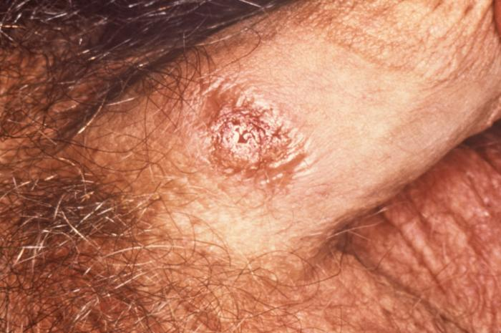
Syphilis

Slide 26
Syphilis

Slide 27
Pubic Lice
Transmitted by close body contact. (not necessarily through sexual contact)
Parasitic insects found in the genitals on pubic hair. ( can be found in mustaches or beards.)
Nickname: (crabs)

Slide 30
Hepatitis B
Most common serious liver infection in the world.
Transmitted through blood to blood, sexual contact, sharing needles, baby to mother.
There is a safe and effective vaccine.

Slide 31
Hepatitis B con’t
Symptoms: yellowish skin (jaundice), loss of appetite, muscle or joint pain.

Slide 32
1. H.I.V.= Human Immunodeficiency Virus
2. A.I.D.S.= Acquired Immunodeficiency
Syndrome
3. Transmitted in 4 bodily fluids.
1. Blood
2. Semen
3. Vaginal fluid
4. Breast milk

Slide 33
HIV
During this period, the virus continues to multiply actively and infects and kills the cells of the immune system.
The virus destroys the cells that are the primary infection fighters, a type of white blood cell called CD4 cells

Slide 34
HIV
Signs and Symptoms
Many people do not develop symptoms after they first get infected with HIV
May experience headaches, fever and tiredness for the first few weeks but those symptoms go away
Even though the person has no symptoms, he or she is contagious and can pass HIV
Last for up to 10 years before it becomes AIDS

Slide 35
AIDS
The later stage of HIV
Happens when cell count gets below a certain point
Sometimes, the diagnosis of AIDS is made because the person has unusual infections or cancers that show how weak the immune system is

Slide 36
AIDS
Infections that happen with AIDS are called opportunistic infections
Pneumonia
brain infection
yeast infection
Weakened immune system can also lead to
Lymphoma
Cancer

Slide 37
*To avoid H.I.V. abstain from risky behaviors that would put you in contact with bodily fluids containing the virus.
1.unprotected sex of any kind
2.sharing needles
If you have put yourself at risk
GET TESTED!!!!
*Right now the #1 prevention is EDUCATION. Know your facts and protect yourself!!! Share this information with friends and loved ones.

Slide 38
AIDS Facts
40 million people are currently living with HIV infection
an estimated 25 million have died from this disease
Globally, 85% of HIV transmission is heterosexual

Slide 39
Index Card Activity
Spend 5 minutes and get FOUR sets of initials from FOUR different people

Slide 41
Sexual Exposure Website
http://www.wishmedical.com/sexual-health/sexual-exposure/sexual-exposure-math/

Slide 42
The End
Pictures from
www.avert.org/std-pictures.htm

