Slide 1
Journal #9
- What character traits do you see in the movie so far? Pick one character and list some of their character traits.

Slide 2
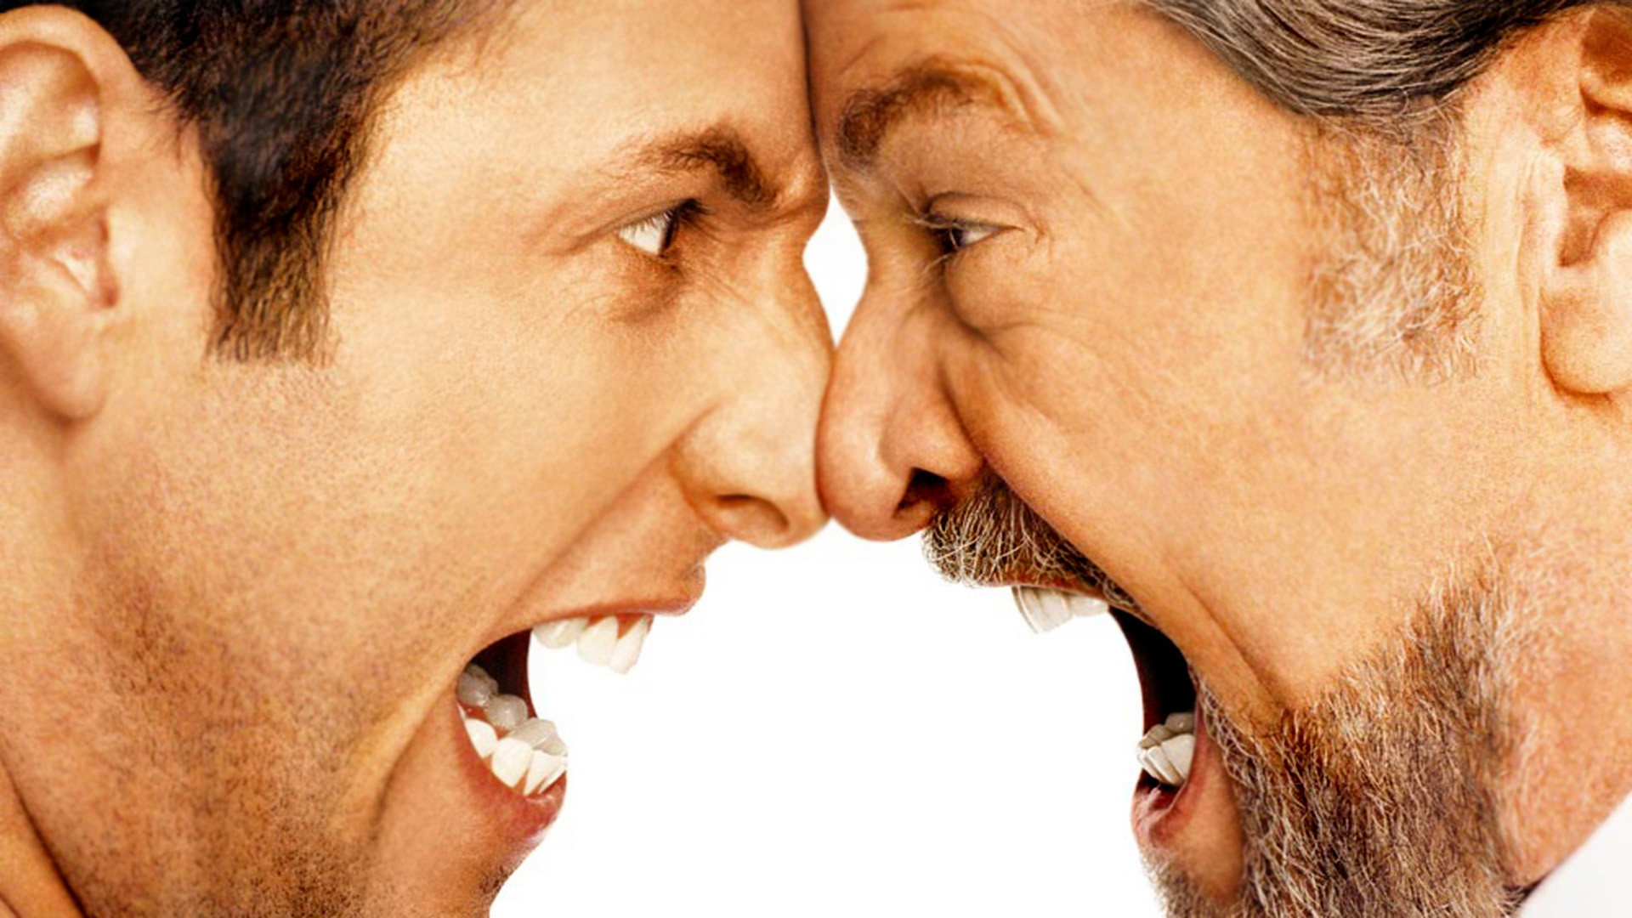
How to respond to anger

Slide 3
Class Discussion
Ways to respond to anger
How do we respond to anger?
Respond to how they are feeling, not the content of what they are saying.
Avoid direct eye contact
Allow angry people to physically escape the situation.
DO NOT defend yourself by attacking back at them on their character flaws.
Do not use sarcasm
Never argue with someone while they are intoxicated

Slide 4
Class Discussion
GOOD listening techniques
Stop talking, its obvious…but not always easy.
Put the speaker at ease.
Show a desire to listen. Act and be interested.
Remove distraction….CELL PHONES
Empathize. Try to put yourself in their shoes.
Be patient. Give them time to finish…don’t interrupt.
Hold your temper.
Ask questions
Eye contact
Give feedback.

Slide 5
Group Activity
In your groups write a scene in which a person must use two of the techniques to respond to an angry individual.
You will act these out in front of the class Today
Write your short script with the names of your group members on a piece of paper.
Your scene must include:
2 ways of responding to anger
Verbal and Nonverbal
Demonstrate you know how to respond in these situations( AT LEAST 60 seconds)
2 minutes of discussion

Slide 6
Pursuit of Happiness Quiz : 25 points
Number 1-5
1. What color suit was Chris wearing in the beginning of the movie?
2. How many people are in the box in the football game?
3. Name the two jobs the wife works.
4. Who directed it? It’s in the end credits?
5. What day is it? ; )

