Slide 1
Journal #17
1)How long is 1st degree CSC punishable for?
2)How long is 2nd and 3rd degree CSC punishable for?
3) Describe CSC in the 1st Degree
4) Describe CSC in the 2nd Degree
5) T or F a person has to be speaking to an individual for it to be considered sexual harassment

Slide 2

Reproductive System
Which one do you have?

Slide 3
The Male
Reproductive System

Slide 4
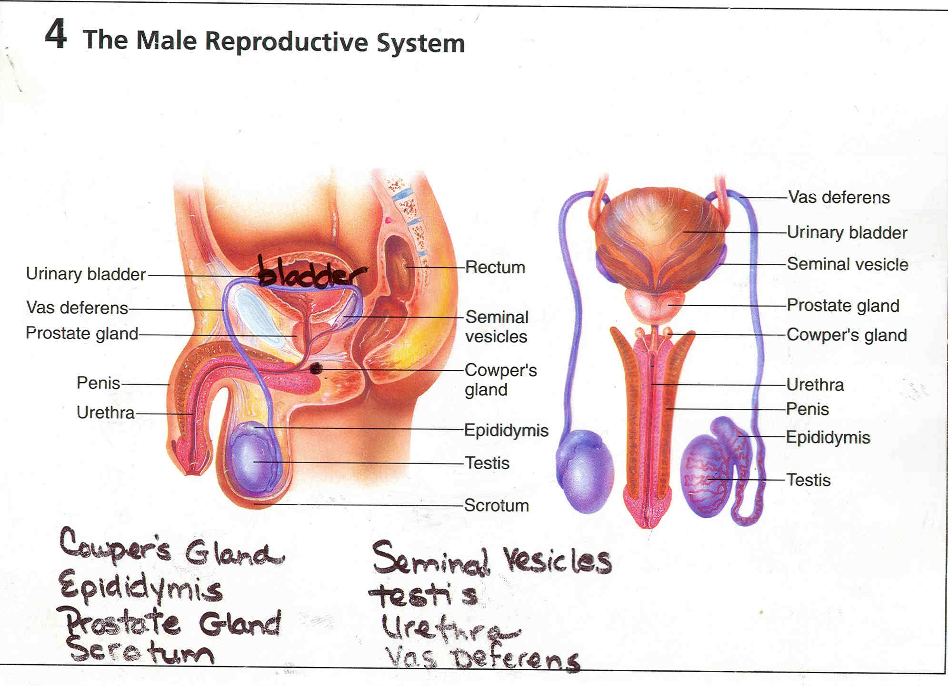

Slide 5
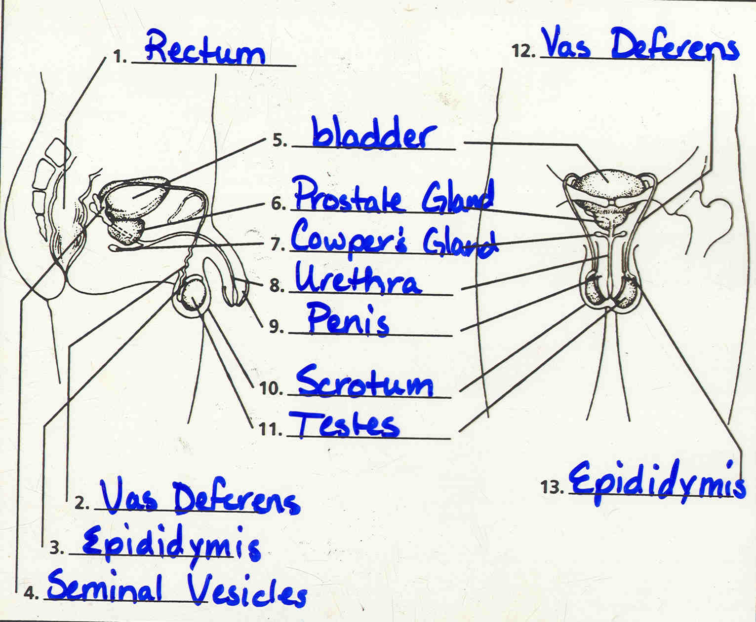

Slide 6


Slide 7
Circumcision : surgical procedure that removes the foreskin from the tip of the penis.
Glands
1. Cowper's Gland : responsible for secreting lubricating mucus
2. Prostate Gland :secrete a fluid that mixes with sperm to
create semen
3. Seminal Vesicles : secrete a significant proportion of the fluid that ultimately becomes semen
Epididymis : sperm are stored after it leaves the testes. Sperm get ability to move.
Semen : above fluids and sperm.

Slide 8
Scrotum : sac of skin that holds the testes.
Testes : 1. Produces testosterone
2. Produces sperm
Testosterone : male hormone
Urethra : urinary tube that passes urine and semen
Vas Deferens : 2 tubes that connect the testes to the urethra. Vasectomy pinches these tubes.

Slide 9
Male and Female Reproductive Systems
Video
https://www.youtube.com/watch?v=G0ZuCilCu3E

Slide 10
The Female
Reproductive System

Slide 11


Slide 12
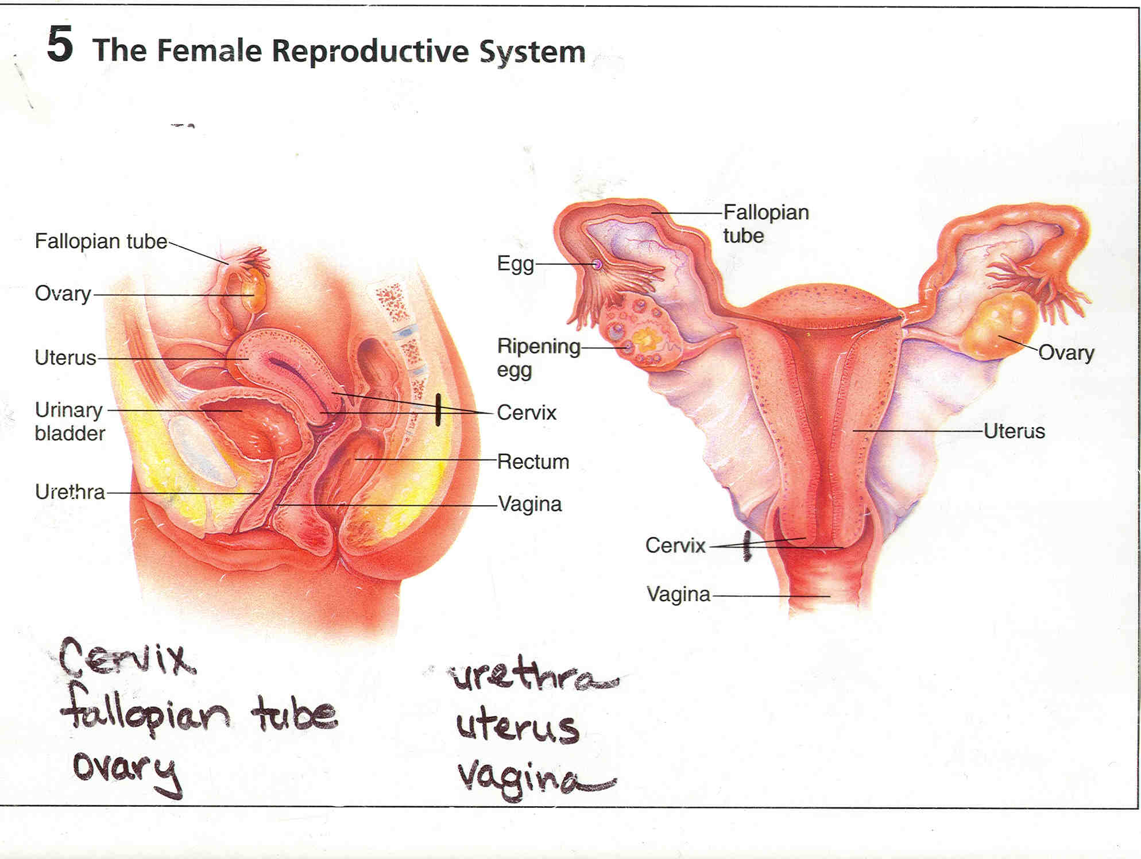

Slide 13
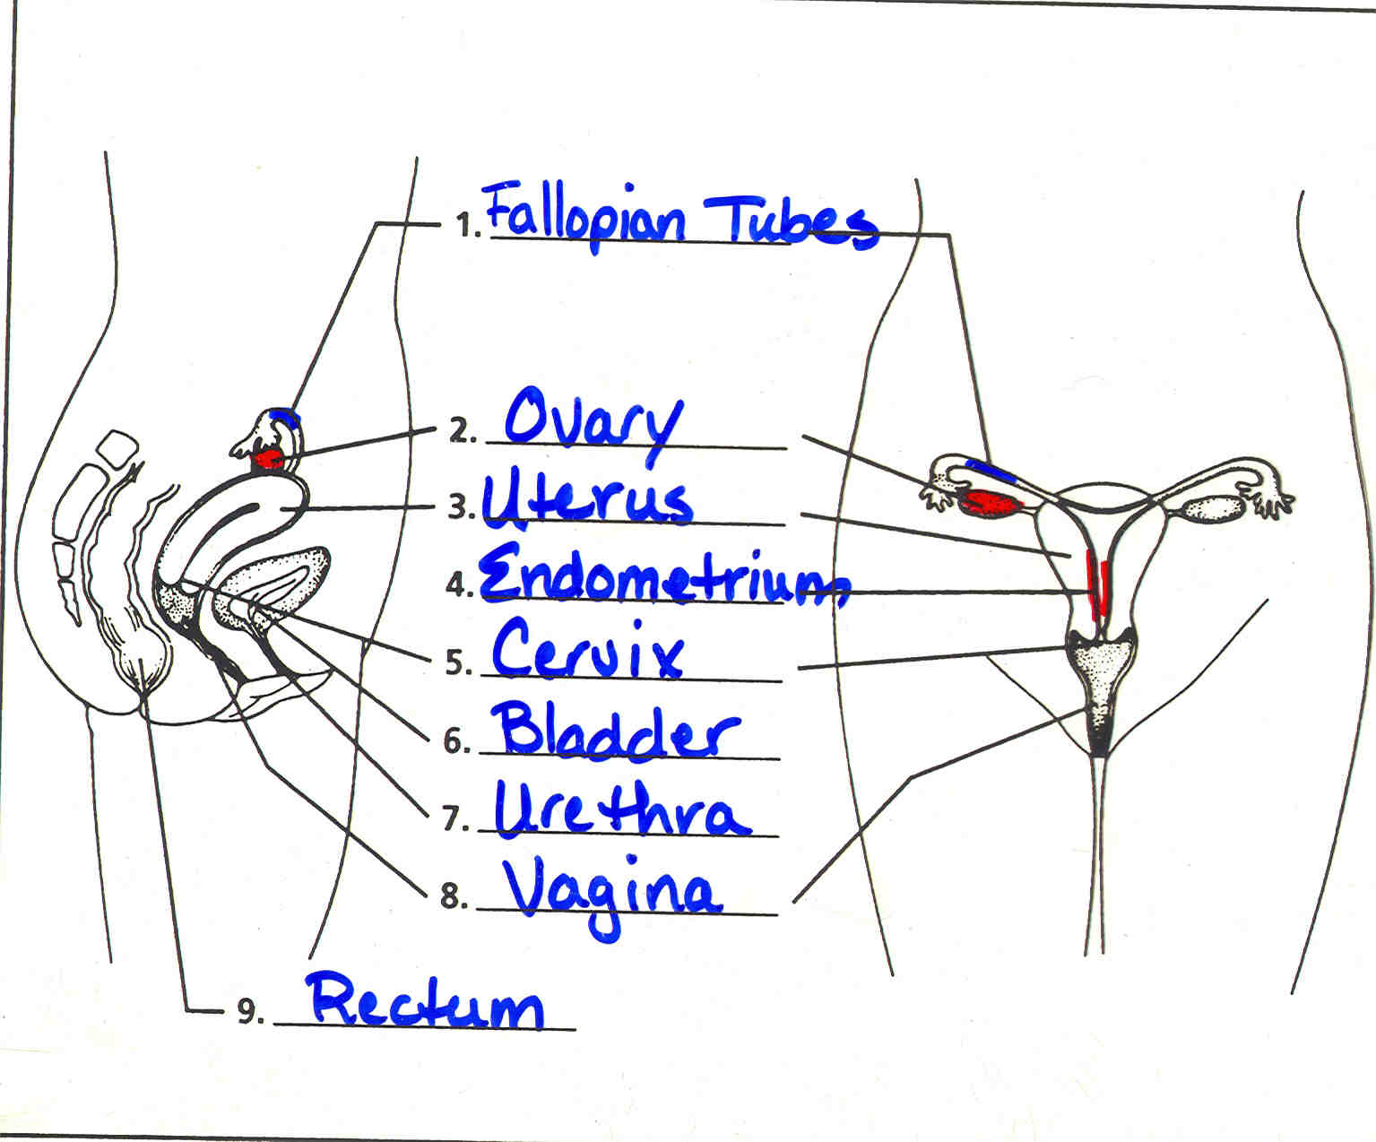

Slide 14
Cervix : bottom of the uterus that dilates during the birthing process.
Endometrium : lining of the uterus. *discharged during menstruation. *
Estrogen/Progesterone : female sex hormone.
Fallopian Tube : 1. Where fertilization occurs.
2. Connects the ovaries to the uterus.
3. Lined with tiny hairs that push the egg.
*Tubes Tied*
Menopause : ceasing of the menstruation cycle. *45-55 years old

Slide 15
Menstrual Cycle : bleeding of the lining of the uterus.
Ovaries : 1. Produce estrogen and progesterone.
2. Produce eggs.
Ovulation : an egg is released in the middle of the menstruation cycle. MOST FERTILE TIME!!
Uterus : pear shaped organ where the fertilized egg implants itself.
Urethra : tube that passes urine to the outside of the body.
Vagina : BIRTH CANAL

Slide 16
Fertilization (Conception)
https://www.youtube.com/watch?v=BFrVmDgh4v4

Slide 17
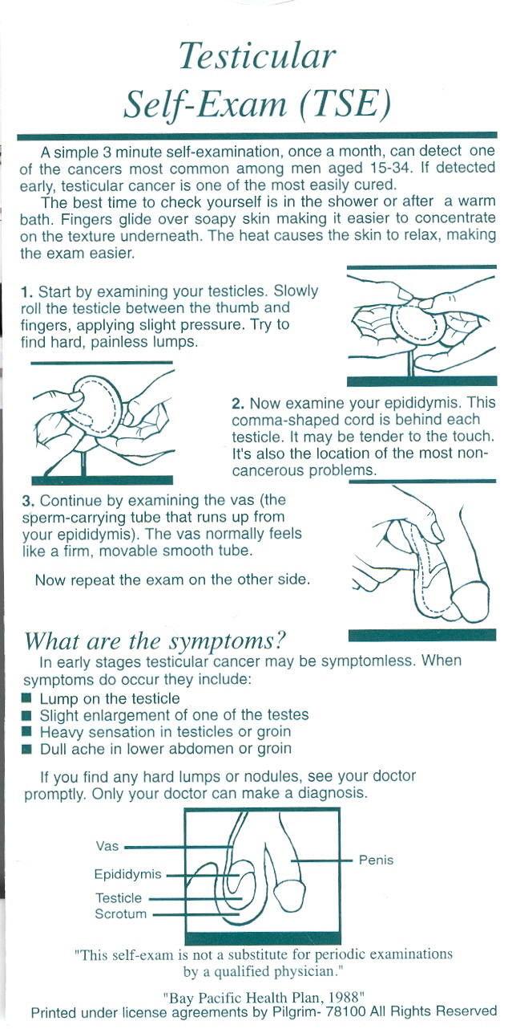

Slide 18
Testicular Self Exam
Video
https://www.youtube.com/watch?v=vbj4NwiQhk8

Slide 19
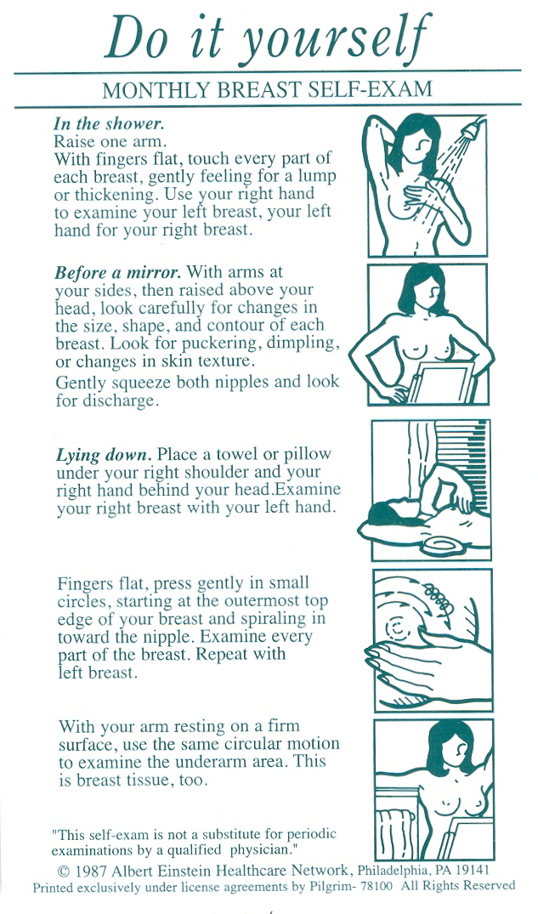
The End

Slide 20
Clinical Breast Exam
https://www.youtube.com/watch?v=1hya8RPM70k
@2:20

Slide 21
THE END

