Slide 1
Journal #28
What is the difference between anorexia and bulimia?
Define purge
Define binge
Eating disorders mostly effect who?
What are the five reasons teens are at risk?

Slide 2
Anorexia- starving oneself
Bulimia- Purging
Purge: to rid the body of food by vomiting or using laxatives.
Binge: to eat large amounts of food over a short amount of time.
1) Emphasis on appearance
2) Perfectionism
3) The need to control
4) Expression of Emotions
5) Media Influence and pressure

Slide 3
Think of a typical week…
Under your journal
Monday | Tuesday | Wednesday | Thursday | Friday
Yogurt Banana Bread Water Coffee
Egg Sandwich
Stir Fry- Onions, red peppers, chicken, ,shredded cheese, egg, water chestnuts

Slide 4
Circle your veggies
Box your fruits
Underline your protein/meats

Slide 5
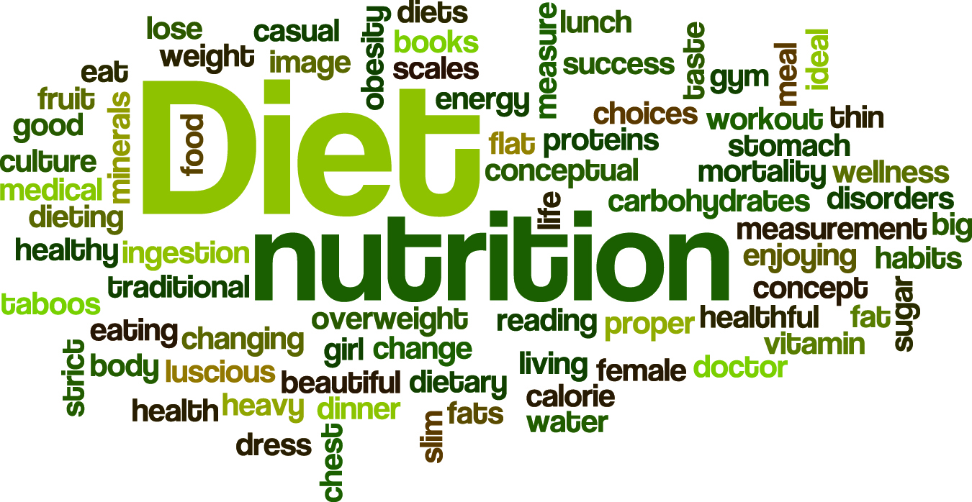
Nutrition Basics

Slide 6
Progression of the Food Pyramid

Slide 7
The Five Food Groups
2
1
5
4
3

Slide 8
Grain
What’s a grain?
Any food made from wheat, rice, oats, cornmeal, barley or another cereal grain is a grain product. Bread, pasta, oatmeal, breakfast cereals, tortillas, and grits are examples of grain products.
Grains are divided into 2 subgroups,
Whole Grains- ex. Brown rice and oatmeal
and
Refined Grains-White bread and white rice
Refined grains do not have as much dietary fiber, iron, and many B vitamins

Slide 9
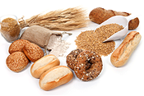
Grain
Nutrients- minerals (iron, magnesium, selenium in whole grain or enriched white bread, carbohydrates, fiber, Vitamin B
Benefits- provide energy
Selection tips – half the grains eaten should be whole grain

Slide 10
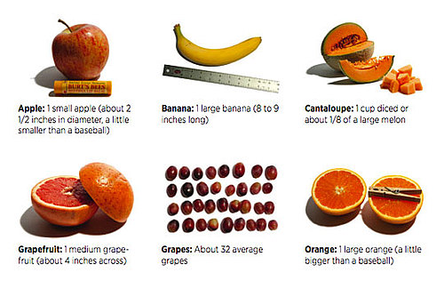
Fruits
Technically, any fruit or 100% fruit juice counts as part of the Fruit Group. Fruits may be fresh, canned, frozen, or dried, and may be whole, cut-up, or pureed.
Recommended Amount
1.5 -2 cups

Slide 11
Fruits
Nutrients: Fiber, vitamins, minerals, simple carbohydrates, and water
Benefits – help growth, heals cuts and scrapes, and provide fiber
Selection tips – choose a variety of fruits of each color. The more colors you eat the more nutrients you get. Limit juice to 100% juice only

Slide 12
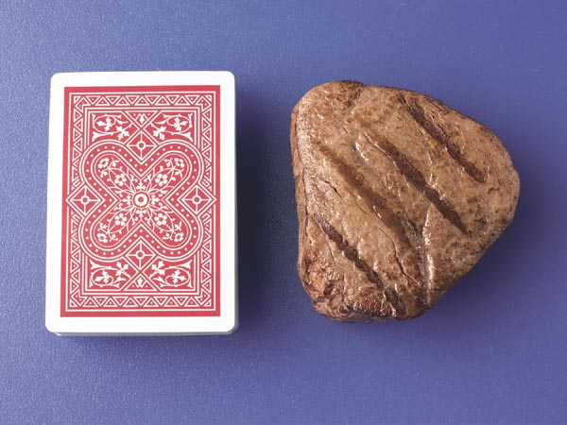
Protein
All foods made from meat, poultry, seafood, beans and peas, eggs, processed soy products, nuts, and seeds are considered part of the Protein Foods Group.
Recommended Amount
5-6.5 ounces
3 Ounces

Slide 13
Protein
Nutrients – minerals, protein, vitamin B and E, Fat (from animal sources
Benefits – This food group helps build muscles and heal your body
Selection tips – choose lean meats and poultry, choose more fish, beans, nuts, and seed

Slide 14
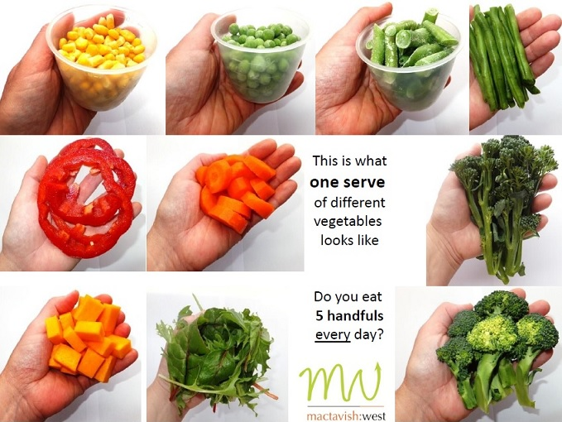
Vegetables
Any vegetable or 100% vegetable juice counts as a member of the Vegetable Group. Vegetables may be raw or cooked; fresh, frozen, canned, or dried/dehydrated; and may be whole, cut-up, or mashed.
Recommended
Amount
5-6.5 ounces

Slide 15
Vegetables
Nutrients – Minerals, carbohydrates, fiber, vitamins,
Benefits – this group provides fiber, helps fight infections, helps cuts and scrapes, prevents strokes and heart attacks
Selection tips – choose a variety of vegetables of all different colors. Choose vegetables more then juice

Slide 16
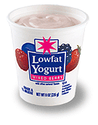
Dairy
All fluid milk products and many foods made from milk are considered part of this food group. Most Dairy Group choices should be fat-free or low-fat. Foods made from milk that retain their calcium content are part of the group. Foods made from milk that have little to no calcium are cream cheese, cream, and butter. Calcium-fortified soymilk (soy beverage) is also part of the Dairy Group.
Recommended
Amount 3 Cups

Slide 17
Dairy
Nutrients – Minerals, protein, vitamin D, fat, water
Benefits – Provides calcium needed to make strong bones and teeth
Selection tips – choose fat free or low fat options

Slide 18
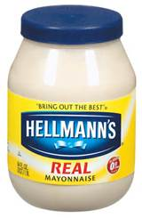
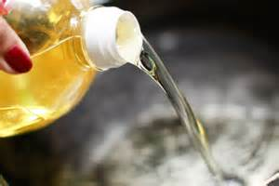
Oil
Oils are fats that are liquid at room temperature, like the vegetable oils used in cooking. Oils come from many different plants and from fish. Oils are NOT a food group, but they provide essential nutrients
Foods that are mainly oil include mayonnaise, certain salad dressings, and soft (tub or squeeze) margarine with no trans fats.

Slide 19
What is a calorie?
A calorie is actually a unit of heat energy.
Your body sees calories as energy and it's energy to produce heat.
And heat energy is what really fuels our body just the same way that gasoline is what fuels your car's energy.

Slide 20
Calories from fat is the number of total calories that are in a product that are directly coming from fat.
For example, my dinner (Progresso Light Chicken Veggie Soup) has a total of 140 calories. Thirty of these calories are from fat. That means that of the 140calories, 21% of the calories are coming from fat.

Slide 21
Where can I find fresh foods?
Saint Clair Shores Farmers Market
http://www.scsfarmersmarket.com/
Local and Fresh - First Farmers' Market in SCS! July 26, Aug 23 and Sept 27 8am-1pm Blossom Heath on the Nautical Mile
Detroit Eastern Market
“On Tuesdays, we offer a scaled-down, more relaxed version of our Saturday Market for stocking up on fresh produce, baked goods and meats. You can take part in a free Zumba or yoga class and watch cooking demonstrations using the great foods found at Eastern Market”

Slide 23
Find More info at:
http://www.choosemyplate.gov/MyPlate

