Slide 1
Journal #12
For people over the age of 21, what is the legal limit to drive?
.08% BAC
What do you know about marijuana?
Laws?

Slide 2
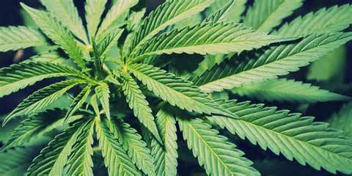
Marijuana(Cannabis)
From the hemp plant and is the most commonly abused illegal drug.

Slide 3
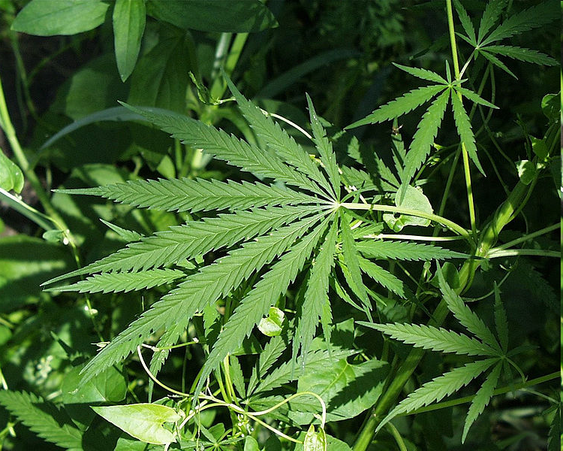
What does it do?
Marijuana is made from the dried leaves and flowers of the plant.
The active ingredient in marijuana that induces a “high” is called THC.
The wild plant is usually lower in THC than cultivated marijuana.
There are many different strengths of marijuana depending on :
Plant strain
Climate
Soil

Slide 4
Short Term Effects of Cannabis
Increased blood pressure and heart rate
Dilated pupils
Impaired coordination and judgment
Short term memory loss
Increased appetite
Distortion of time and space
Redness of eyes
Exaggerated laughter
Long term use can result in bipolar disorder, major depression, schizophrenia
Damage to lungs and liver.
Cancer
Heart disease
Lung damage
Damage to reproductive systems
Immune system

Slide 6
Long Term Effects
Similar cancer-causing compounds as tobacco, sometimes in higher concentrations
Smoking five joints per week may be taking in as many cancer-causing chemicals as someone who smokes a full pack of cigarettes every day

Slide 7
The amount of THC in marijuana has gone up in recent years. Most leaves used to contain between 1% and 4% THC. Now most have closer to 7%.
Even if you buy from a legal, state-regulated dispensary, it can be hard to know exactly how much THC or other compounds found in marijuana you’re ingesting

Slide 8
If you’re a man, heavy use could lower your testosterone levels, and your sperm count. That can lower your libido and in some cases effect your fertility.
Those who used marijuana heavily as teenagers and quit using as adults did not recover the lost IQ points. Users who only began using marijuana heavily in adulthood did not lose IQ points. These results suggest that marijuana has its strongest long-term impact on young users whose brains are still busy building new connections and maturing in other ways.

Slide 9
Lets Break this down
https://www.youtube.com/watch?v=FvszaF4vcNY

Slide 10
So…Smoking Marijuana is better than cigarettes, right?
The American Lung Association (ALA):
Marijuana smoke contains four times as much tar and tobacco-based cigarette smoke. Like tobacco smoke, marijuana smoke contains cancer-causing chemicals.
There are 33 cancer-causing chemicals contained in marijuana. Marijuana smoke also deposits tar into the lungs. In fact, when equal amounts of marijuana and tobacco are smoked, marijuana deposits four times as much tar into the lungs. This is because marijuana joints are un-filtered and often more deeply inhaled than cigarettes.

Slide 12
“Vaping” Marijuana
Dabbing or Vaping is inhaling the potent vapors from concentrated marijuana oil which is up to 80% THC.. Compared to 7-8% THC in a joint.
https://www.youtube.com/watch?t=236&v=4gFgvCi-JGw

Slide 13
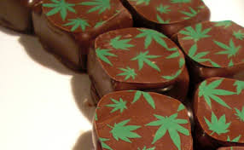
What are Edibles?
Edibles give users a different kind of high than the one they get from smoking marijuana, largely because the pot is absorbed through the stomach instead of the lungs. The effects are slower to arrive, generally last longer and can be more intense because people unknowingly eat more than they intend to. On the other hand, people who smoke pot get high quickly, allowing them to better regulate how “high” they're getting.

Slide 14
In the News
http://www.denverpost.com/news/ci_25475533/denver-coroner-man-fell-death-after-eating-marijuana

Slide 15
The Law
So… it’s legal in some areas? Not exactly, this is a battle between state law and federal law:
https://www.whitehouse.gov/ondcp/state-laws-related-to-marijuana
http://michiganradio.org/post/these-14-cities-michigan-have-passed-laws-decriminalizing-marijuana-possession-and-use#stream/0

Slide 16
Schedule 1 Drug
Schedule I drugs are those that have the following characteristic according to the United States Drug Enforcement Agency:
The drug or other substance has a high potential for abuse.
The drug or other substance has no currently accepted medical treatment use in the U.S.
There is a lack of accepted safety for use of the drug or substance under medical supervision.
No prescriptions may be written for Schedule I substances, and they are not readily available for clinical use.
NOTE: Tetrahydrocannabinol (THC, marijuana) is still considered a Schedule 1 drug by the DEA, even though some U.S. states have legalized marijuana for personal, recreational use or for medical use.

Slide 17
Under federal law, possession by itself is a misdemeanor punishable by up to one year in prison and a fine for a first offense.
Factors included:
Amount
Location
Previous Criminal Record
In Michigan: It is a crime to knowingly or intentionally possess any amount marijuana (including small amounts for personal use) in Michigan. Penalties include a fine of up to $2,000, up to one year in jail, or both.

Slide 18
I heard it can help “cure” things
Well…not really:
http://news.discovery.com/human/cannabis-chemical-chills-out-reaction-to-pain-121221.htm
What’s this similar to?

Slide 19
Marijuana Testing
Saliva: 3 days
Urine: 5-30 Days
Blood: 1 week
Hair: Detection period of 90 days- 1year
All of he following are based frequency and BMI.

Slide 20
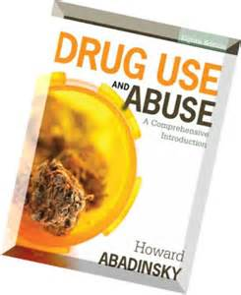
More Info:
http://www.drugabuse.gov/drugs-abuse/marijuana
https://www.whitehouse.gov/ondcp/about
http://www.mayoclinic.org/

