Slide 1
Michigan Laws

Slide 2
Age of Consent
What is consent?
Consent is an agreement between participants to engage in sexual activity.
In MI, the age of consent is 16, unless one person is in a position of authority, then it is 18.

Slide 3
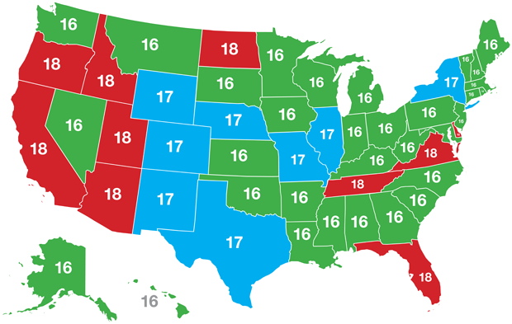
Around the US

Slide 4
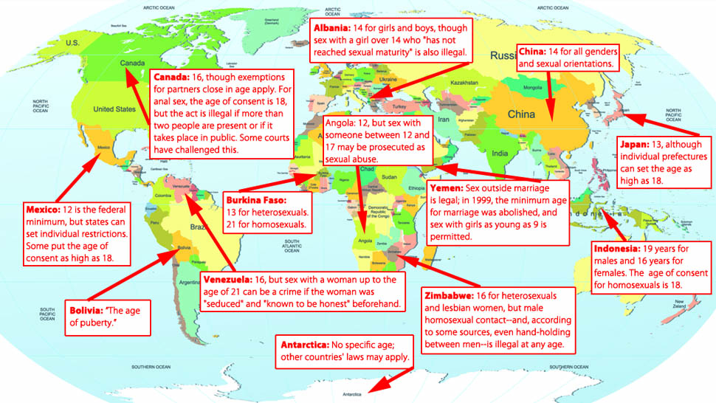
Around the World

Slide 5
You CANNOT be intoxicated or under the influence of drugs to give consent
Consent is NEVER implied
https://www.youtube.com/watch?v=fGoWLWS4-kU

Slide 6
Sexual Harassment
What is it
Intimidation, bullying or coercion of a sexual nature, or the unwelcome or inappropriate promise of rewards in exchange for sexual favors
Verbal or written, such as sexual innuendoes, jokes, or comments
Physical, such as assault or inappropriate touching
Nonverbal, such as offensive gestures or expressions
Environmental, such as displays of drawings, posters, or objects of a sexual nature

Slide 7
Sexual Harassment
What happens to people if they sexually harass others?
Fired from workplace
Transferred
Wages cut
May have legal penalties as well

Slide 8
Sexual Harassment
Sexual Harassment is most common in the workplace
You must notify your employer of the unwelcome sexual behavior for the employer to be liable
Employers are not allowed to fire, transfer, or otherwise retaliate against you if you report a charge of sexual harassment

Slide 9
Michigan Criminal Sexual Conduct Laws
4 Degrees with
Felony (1-3) and/or
Misdemeanor (4) charges

Slide 10
Degree’s in a “Nutshell”
CSC in the first, second, or third degree is a felony.
CSC in the fourth degree, which only involves forceful touching, is a misdemeanor punishable by two years.
Basically, first and third degree CSC involve penetration.
First degree involves aggravating circumstances.
CSC in the second degree only involves contact with some of the aggravating circumstances present in criminal sexual conduct first degree.

Slide 11
Penetration Vs. Contact
Penetration:
Degree 1-penetration anyone under 13-16 (MINOR)
Degree 3- penetration anyone between 13-16 (MINOR)
*No need to prove force only age and penetration.*

Slide 12
Penetration Vs. Contact Cont.
Contact
2nd Degree and 4th Degree
Intentional touching of intimate parts for purpose to gain sexual arousal or gratification

Slide 13
A person is guilty of CSC in the first degree if:
He/she engages in sexual penetration w/another person and the following:
Victim under 13, or between 13 and 16
Less than 16 if related/live with or in authority over victim.
Physically, mentally incapable/helpless/disabled
Use force to accomplish penetration
A felony punishable by up to life in prison.

Slide 14
A person is guilty of CSC in the second degree if:
He/she engages in Sexual Contact w/another person and the following:
Victim under 13, or between 13 and 16
Less than 16 if related/live with or in authority over victim.
Physically, mentally incapable/helpless/disabled
Use force to accomplish contact
Felony punishable by up 15 years in prison

Slide 15
A person is guilty of CSC in the Third degree if:
He/she engages in Sexual Penetration w/another person and the following:
between 13 and 16
Use force to accomplish penetration
Perpetrator knows or has reason to know the victim is mentally incapable, mentally incapacitated or physically helpless
Felony Punishable up to 15 years in prison

Slide 16
A person is guilty of CSC in the Fourth degree if:
He/she engages in Sexual Contact w/another person and the following:
Force used to accomplish sexual contact including but not limited to any of circumstances for 1-3
Perpetrator knows or has reason to know the victim is mentally incapable, mentally incapacitated or physically helpless
Victim under the jurisdiction of the department of currection and the perp is an employee with knowledge of under jurisdiction age (16).
Misdemeanor up to but no more than 2 years in prison or by fine not more than $500.

Slide 17
Sexting and the Law
https://www.youtube.com/watch?v=oy7F4cNEwFk
Start @15:50- 28 mins
Romeo
https://www.youtube.com/watch?v=0u1aO7TuBfI

Slide 18
To Break it Down:
Taking a photo:
20 year felony
Asking for a photo:
20 year felony
Sending a photo:
7 year felony
Having it or keeping it:
4 year felony

